Slide 1
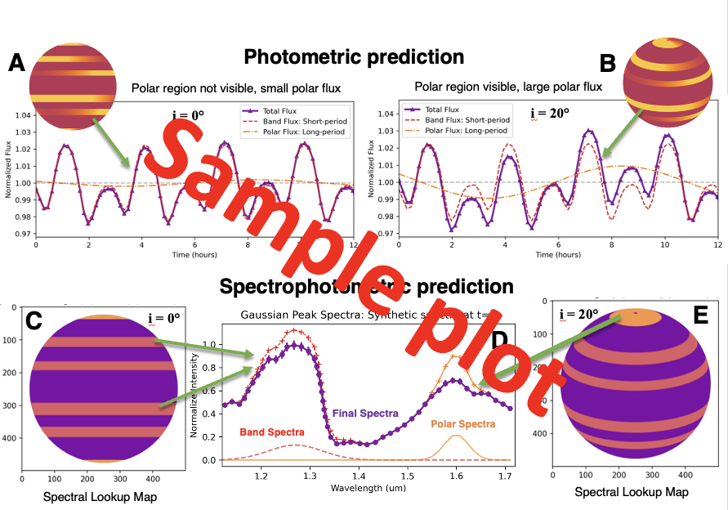

Slide 2
Extracted features via PCA
Sample plot
High-inclination: long-period component dominates
Low-inclination: short-period component dominates

Slide 3
Sample plot
A: All modulation comes from bands
B: Uniform, time-variable polar-cap
C: Dynamic polar vortices

Slide 4
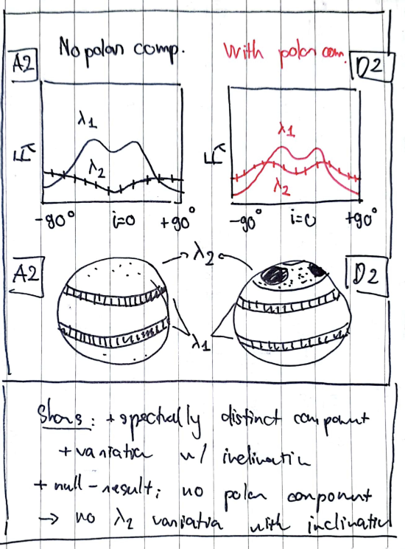
Null hypothesis: no polar vortices, long-period changes come from band.
Long-period strength decreases with inclination
Hypothesis: long-period changes come from polar region.
Long-period strength increases with inclination,
Sample plot

